Slide 1
Lexical content for Yemba:
First version of TEI dictionary
Lionel TADJOU
Research engineer at INRIA

Slide 2
Outline
Context
What have been done ?
The Yemba language – Corpora
First version of TEI Yemba dictionaryWhat

Slide 3
What have been done ?
TEI dictionary
XSLT course
How to use Grobid-dictionaries
Data management practicies

Slide 4
What have been done ?
TEI dictionary
XSLT course
How to use Grobid-dictionaries
Data management practicies

Slide 5
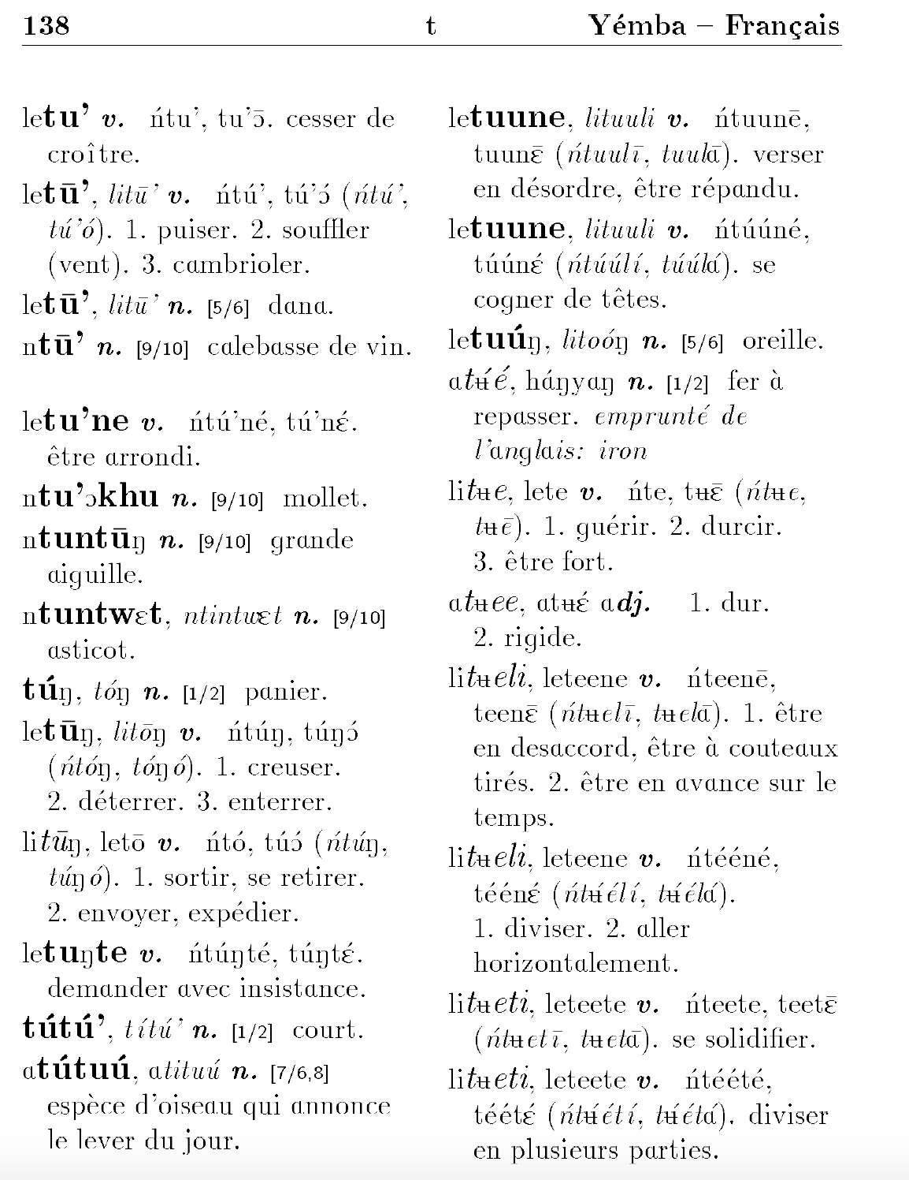
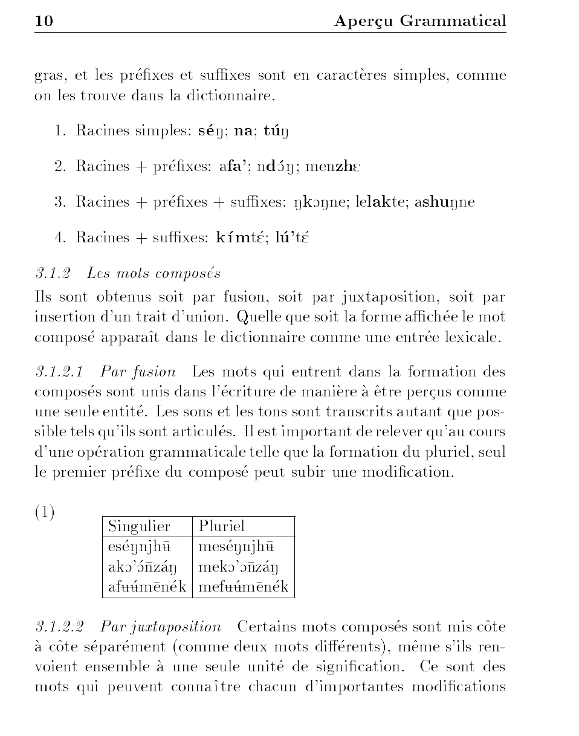
The Yemba language – Corpora

Slide 6
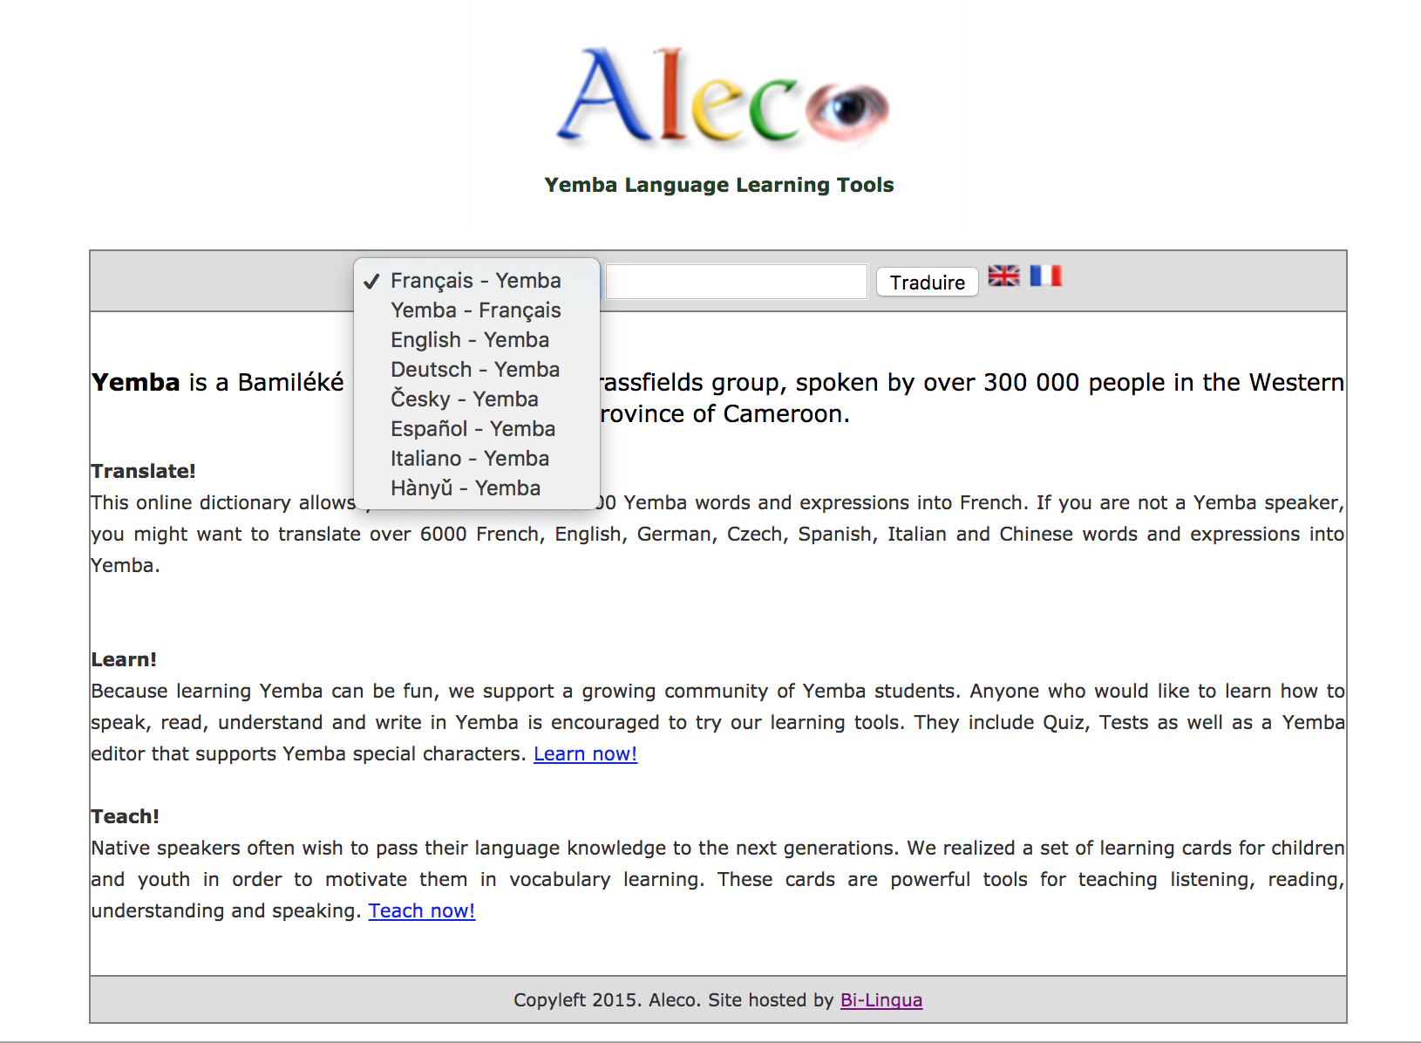
First version of TEI Yemba dictionary
Start encode it manually
Grobid dictionaries not able to process my dictionnary
http://yemba.net/wdict/index.php

Slide 7
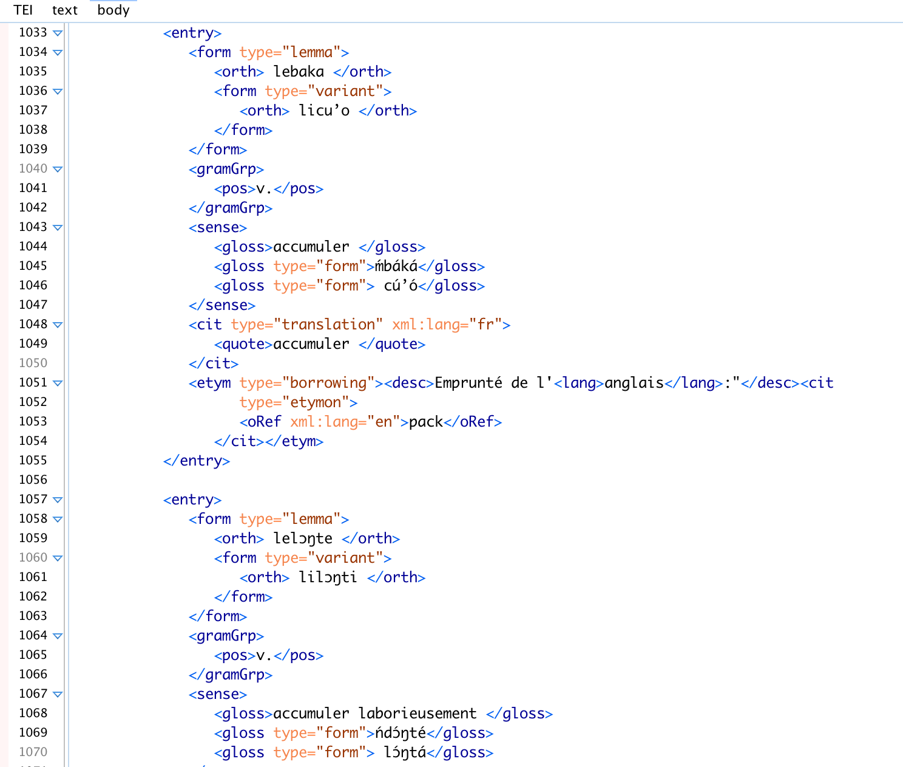
First version of TEI Yemba dictionary
JAVA application to fetch data from yemba.net
Auto-generated TEI dictionary for Yemba

Slide 8
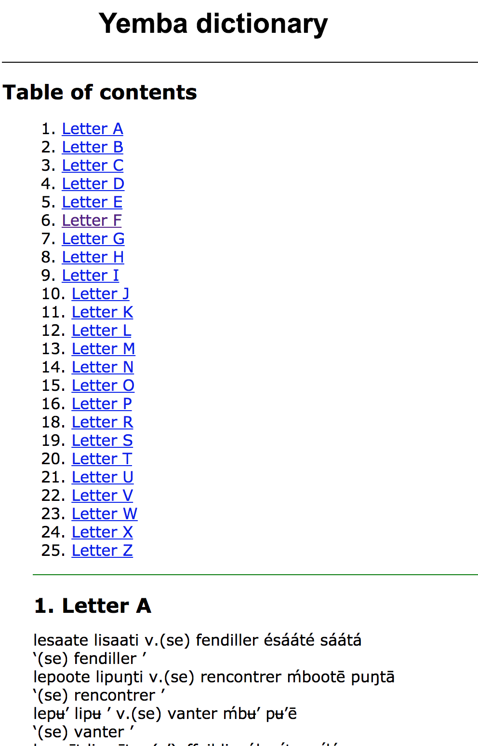
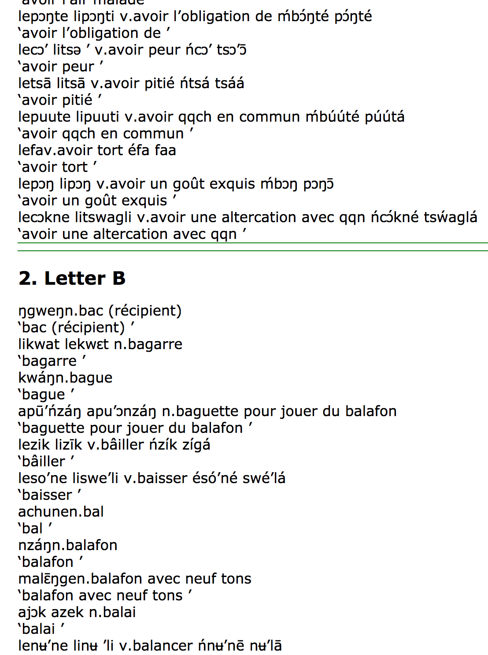
First version of TEI Yemba dictionary

Slide 9
Summary
First step of my project : Done
Learn more about TEI & XSLT : Done
Creation of lexical content for Yemba language : Done

Slide 10
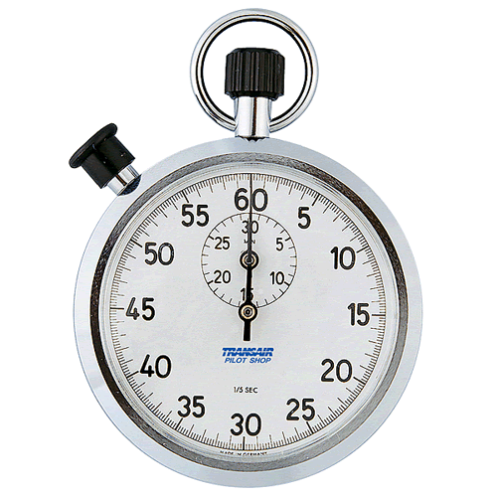


Time’s Up!
About your speaker:
  Name: Lionel TADJOU
  Institution: INRIA Paris
  Social Media:
    https://www.linkedin.com/in/tatali/
    @Ntatali
  Quick bio:
  Hold a Master degree.
  Research engineer at Inria Paris, Web developer for the PARTHENOS project, designing the Standardization Survival Kit (SSK) a platform dedicated to support research in Arts and Humanities researchers.

